Slide 1
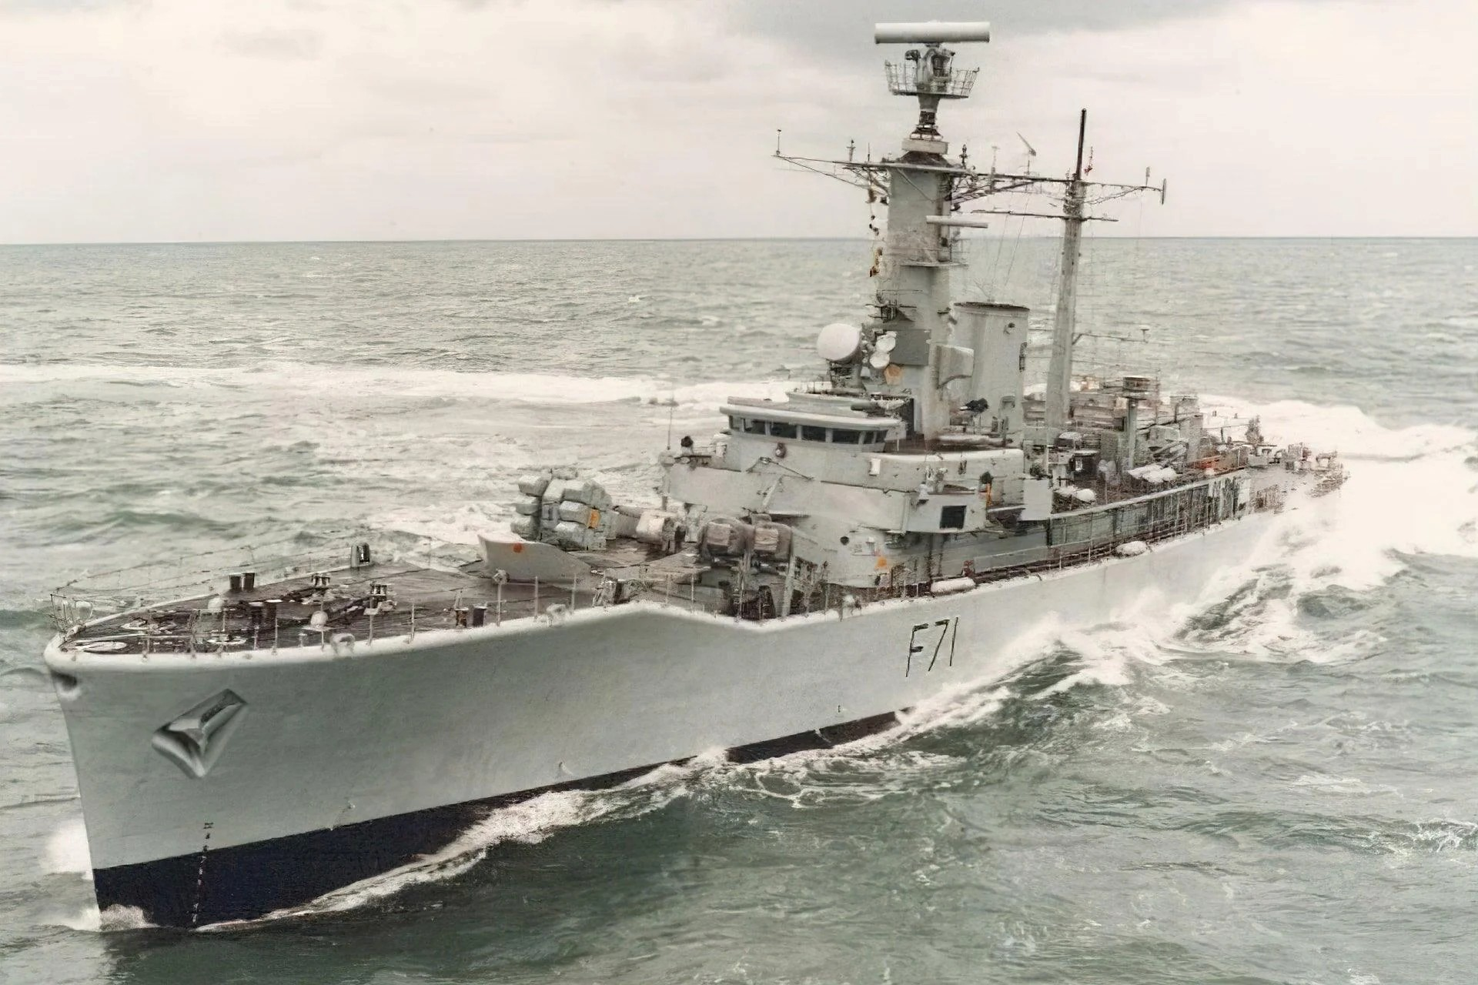
York Sub Aqua Club HMS Scylla Dive Brief
Chris Chittock

Slide 2
HMS Scylla
Preliminarys
20/5/25
Chamber On Line √
Equipment Serviceable √
Medically Fit √
Any Medication √

Slide 3
HMS Scylla
Eliments
Weather - Cloudy
Wind – W 6 – 10 Knots
Sea State - Slight
High Water – 10:56, Height = 4.7m
Low Water – 16:50, Height = 1.8 m
Tidal Range – 2.9 m
Barometer - 1011
Table Level - A1
Air Temp – 18 Degrees
Sea Temp – 16 Degrees

Slide 4
HMS Scylla
The Dive
Aim – Scenic wreck dive with DO3 elements
Site - HMS Scylla
Alt Site – Cawsands Bay
Site Depth 22m
Bottom – Wreck & Sand with broken shell
Current – 011 Degrees – 0.4 knots

Slide 5
HMS Scylla
The Plan
Computer – 20 – 22 m
Surface to Surface – 45 Minutes
Stops – 3 @ 6m
Actions on computer fail – 3 @ 6m
Limits of Deco – 5 Mins
Check your computer prior getting on the boat
Gas
Reserve – 70 Bar or 1/3
Nitrox Mix – Max 36
MOD – 30 m
Cylinder pressure – 210> Bar
Kit – Full SCUBA

Slide 6
HMS Scylla
Dangers
Uncontrolled Ascent
Entrapment
Separation
Surface Traffic
Sharps
Entanglement
Recall – Thunder Flash or 4 Pulls
EAP
Recover
Assess
React
Evacuate

Slide 7
HMS Scylla
Buddy Pairs
Boat 1
Andy A & Marie – W 1
Jacqui & Glyn – W 1
Bryan & Bob – W 2
Boat 2
Chris & Sam - W 1
Aaron & Barry – W 1
Andy M & Jo – W 2
Skills & Drills
Dive Lead
Mid Water DSMB

Slide 8
HMS Scylla
Support Roles
Dive Manager – Chris
Assistant Dive Manager – Andy M
Cox B1 – Kev
B1 O2/First Aid Kit – Marco
Cox B2 – Bronte
B2 O2/First Aid Kit - Ian

Slide 9
HMS Scylla
Team Tasks
O2’s – Andy A
Water – Marie
Life Jacket Bag – Jacqui
Thunder Flash’s & Flares – Andy M
Shot, Line & Buoy – Glyn
First Aid Kit’s – Bryan
Flask – Bob
Spare Weights/Clip ons – Sam
Warm Clothing - All

Slide 10
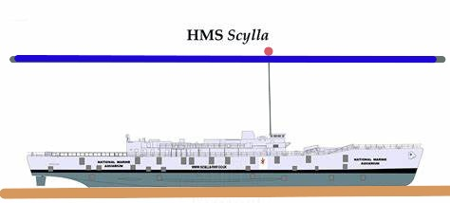
HMS Scylla

Slide 11
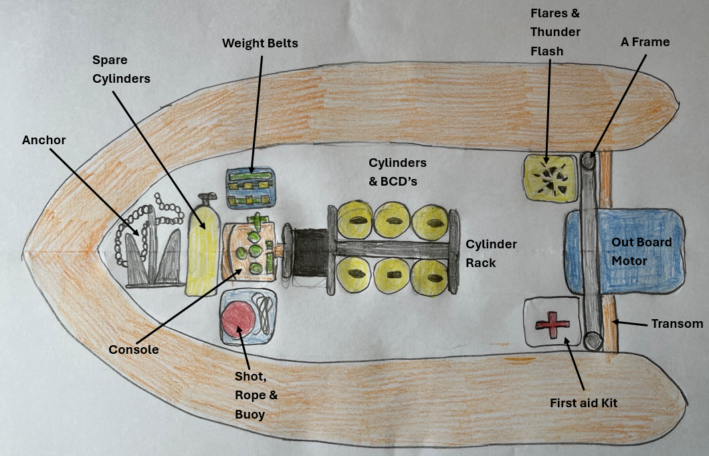
HMS Scylla

Slide 12
HMS Scylla
Any Questions

Slide 13
Keep in touch
bsac.com facebook/britishsubaquaclub | twitter.com/bsacdivers
(0)151 350 6200 | info@bsac.com

